Slide 1

Adaptive Size-Aware Cache Insertion Policy for Content Delivery Networks
Peng Wang∗, Yu Liu†, Zhelong Zhao∗, Ke Zhou∗, Zhihai Huang‡, Yanxiong Chen‡ ∗WNLO, Huazhong University of Science and Technology, Wuhan, China
†Huazhong University of Science and Technology, Wuhan, China
‡Tencent Technology (Shenzhen) Co., Ltd., Shenzhen, China
ICCD 2022
Notes:
Hello，everyone:
It’s very great pleasure indeed for me to attend this meeting. And I would like to present my paper “adaptive size-aware cache insertion policy for content delivery networks”.

Slide 2



CDN Caching Goal: Minimize WAN Traffic
Requests
Requests
Hit
User
Edge Cache
Miss
Wide Area Network (WAN) traffic is expensive.
Optimize the caching replacement algorithm to reduce WAN traffic is important.
Notes:
CDN delivers the content from thousands of tenants to users that the content is managed by a large network of caches. The goal of CDN cache management is to minimize Wide Area Network traffic. Optimizing cache replacement algorithms is a common and effective means of improving cache hit rates and reducing WAN traffic.

Slide 3
Replacement algorithms remains challenging
replacement algorithm = Insertion policy + victim selection policy
Victim selection policy are well researched (LRU, LRUK, LFU, LRB…).
Insertion policy?
Past replacement algorithms insert incoming objects into the low eviction priority (i.e., MRU position in LRU).
Based on this assumption: objects that have just been requested usually have a high probability of being reused.
Notes:
We first pay attention to the cache replacement algorithm, consisting of the insertion policy and the victim selection policy. Traditional caching algorithms have done a lot of good research in terms of victim selection policy. As for insertion policy, past replacement algorithms often insert the incoming objects into the low eviction priority. They are all based on the same empirical assumption that objects that have just been requested still have a higher chance to be requested in the future.

Slide 4
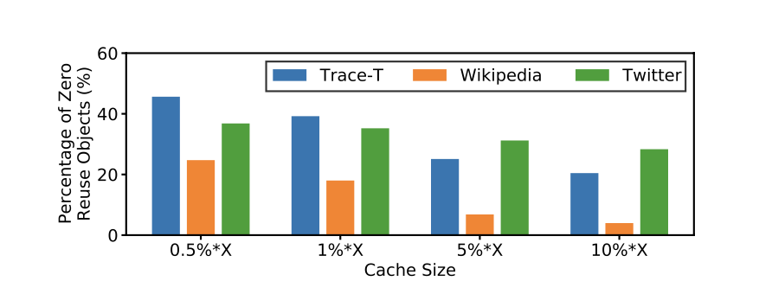
Is this assumption reasonable?
Zero-reuse objects are those that are not accessed from the time they are written to the cache to the time they are evicted from the cache.
The waste of cache resources with limited object hit ratio forces us to find solutions to deal with these zero-reuse objects.
Notes:
However, is this assumption reasonable? We look at this question in the context of CDN. First, when we tested the performance of the LRU algorithm, we found that there are many zero-reuse objects. Zero reused objects are not accessed from the time they are written to the cache to the time they leave the cache. Obviously, the existence of these zero-reuse objects wastes the cache resources and affect the performance of the cache. Therefore, this paper attempts to improve the performance of the cache by handling these zero-reuse objects.

Slide 5
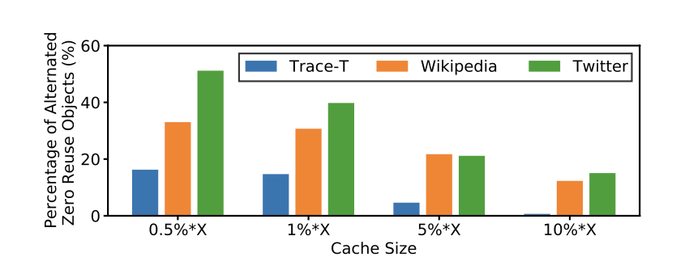
Cache or not cache?
An intuitive solution is not to cache these objects, as admission algorithms do.
But zero-reuse objects may not always be zero-reuse.
zero-reuse objects with a dynamic state are difficult to predict.
Notes:
An intuitive solution is to keep these zero-reuse objects out of the cache, just like what admission algorithms do. However, we find that the zero-reuse status of an object can change and such changes are often caused by variable workloads. As shown in the figure, we counted the percentage of objects whose zero-reuse object status changed in the process. Those zero-reuse objects with dynamic state are difficult to predicte.

Slide 6
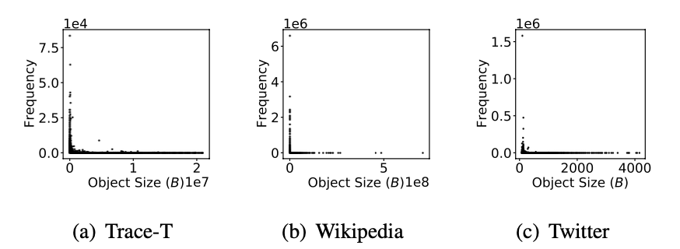
Rationale for size-aware
The dots with high positions are concentrated to the left of the x-axis in the three sub-figures, which demonstrates that the small objects in the cache are likely to be accessed more frequently than the relatively large objects.
Notes:
We try to find some characteristics of zero-reuse objects. When analyzing for those CDN traces, we found that the object sizes in CDNs are very different. When we counted the frequency of each object, we found that the frequency of some smaller objects was often higher than that of some larger objects, as shown in the figure.

Slide 7
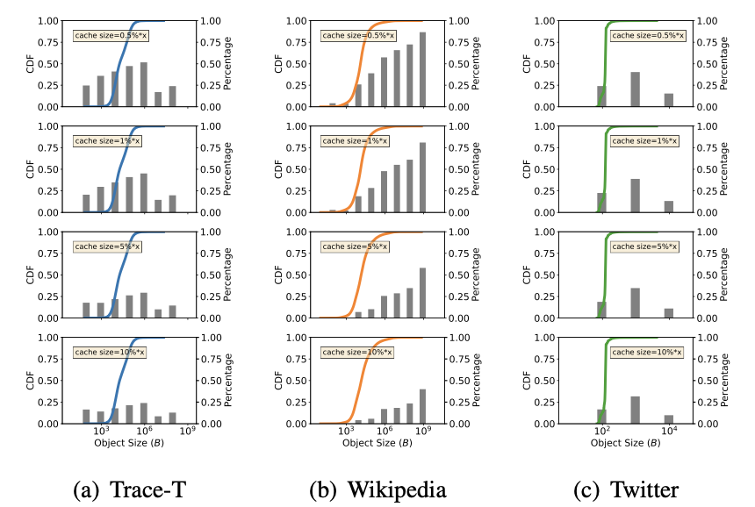
Rationale for size-aware
Zero reuse objects are related to object size！
Some observations:
The curves vary with the traces while they are insensitive to cache sizes.
The percentages vary with the traces, while increasing cache sizes will not significantly change the overall trend of the percentages
Notes:
To figure out the distribution of zero reuse objects, we counted the cumulative distribution of zero reuse objects’ size and the percentage of zero reuse objects in different size regions. Then, we have the following findings.
(1) The curves vary with the traces while they are insensitive to cache sizes. It means that the trace’s size distribution determines the distribution of zero-reuse objects, which is almost independent of cache size.
(2) The percentage varies with the traces, while increasing cache sizes will not significantly change the overall trend of the percentage, but will reduce the values within each size region. It proves that the cache size has an impact on the number of zero-reuse objects.
This evidence confirms the correlation between the zero-reuse objects and the object sizes, motivating us to continue the exploration of insertion policy in a size-aware manner.

Slide 8
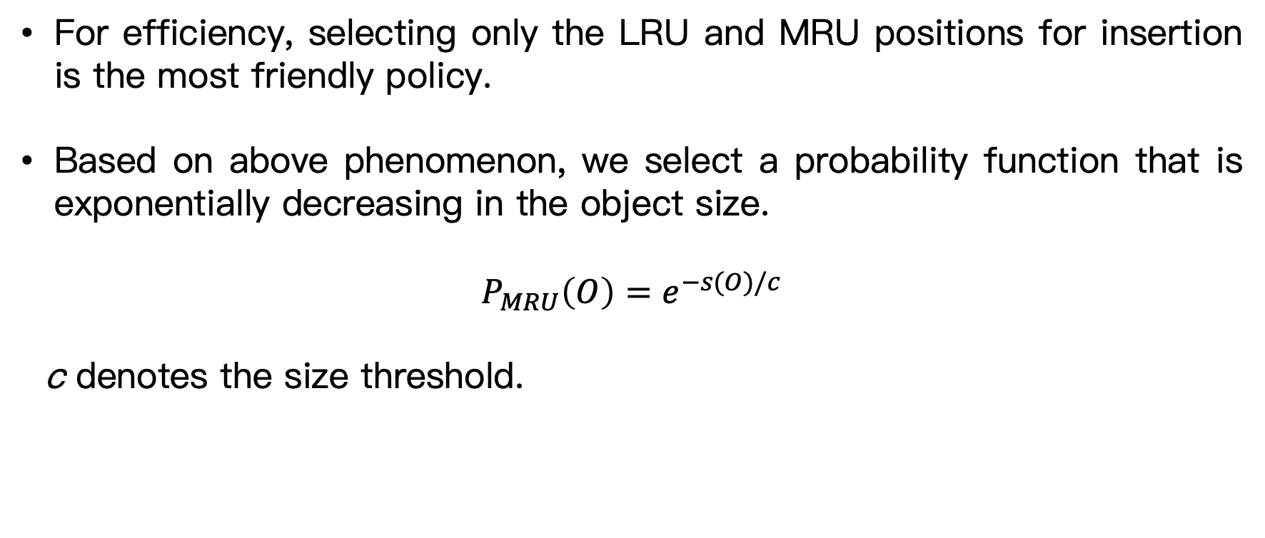
Introducing adaptive size-aware cache insertion policy (ASC-IP)
For efficiency, selecting only the LRU and MRU positions for insertion is the most friendly policy.
Based on above phenomenon, we select a probability function that is exponentially decreasing in the object size.
$$P_{MRU}\left(O\right)=e^{−s(O)/c}$$
c denotes the size threshold.
Notes:
We desire suspected zero-reuse objects to have fewer hit chances than other objects by adjusting the initial insertion position of the object. In order to keep the data structure in the original caching algorithm, we choose to only insert at the head or tail of the cache queue. Based on above phenomenon, we select a probability function that is decreasing in the object size. The probability of insertion into MRU position can be calculated using the above equation.

Slide 9
Dynamic tuning with history list
Referring to ARC, we construct a shadow cache with the virtual same capacity as the real cache to maintain a history list.
In a FIFO manner, the history list only receives metadata (such as key and size) of the objects evicted from the real cache.
Notes:
To dynamically adjust the threshold size, we draw on the experience of the shadow cache in ARC, by setting up a history table in a FIFO manner, to record the metadata information of the objects evicted from the cache. The size of the history table equals the size of the cache.

Slide 10
ASC-IP
We add two Boolean labels, i.e., hit_tag and mru_tag into each object’s metadata, where hit_tag represents the object whether being hit in the cache in a time window, and mru_tag denotes the object whether being inserted into the MRU position.
Thus, For each object in or out of the cache, there are only four states of (mru_tag, hit_tag), including (T,T), (T,F), (F,T), and (F,F).
Notes:
Then, the specific implementation details of ASC-IP. We add two labels for each object with Boolean variables. A hit tag and an insertion tag. The insertion tag is True when the incoming object is inserted at MRU position. Therefore, based on the values of these two tags, we can classify all the objects into 4 kinds.

Slide 11
ASC-IP
Case1: (mru_tag, hit_tag ) = (T,F)
The inserted object does not contribute any OHR but is inserted into the MRU position.
Therefore, the size threshold c should reduce by an adjustment step.
Case2: (mru_tag, hit_tag ) = (F,F)
If the object exists in the history list, the size threshold c must increase by an adjustment step so that the next incoming object with such size is more likely inserted into the MRU position.
Notes:
For two of these cases, we believe that the threshold c should be adjusted.
The first one is, the case of insertion at MRU, but no hit. This case indicates that the threshold c is set too large, resulting in objects that should have been awarded zero-reuse based on the threshold size being inserted at the MRU. Therefore, the threshold should be reduced appropriately.
The second case is when there is a cache miss, but the requested object exists in the history table, if the two tags happen to be False, it means that our threshold is set too small, resulting in a cache miss. Thus, the threshold should be increased.

Slide 12
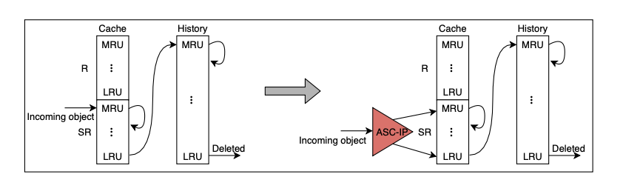
Integration with cache replacement algorithms
As an insertion policy, ASC-IP can decide the initial position of the incoming object in the cache. It not only does not interfere with the eviction policies of existing cache replacement algorithms but also can improve their insertion policies, resulting in the adaptation to scenarios with inconsistent object sizes.
Notes:
Accordingly, we designed the ASC-IP. We point out that since the ASC-IP algorithm does not change the data structure in the original algorithm, as an insertion policy, ASC-IP can decide the initial position of the incoming object in the cache. So it can integrate with other cache replacement algorithms easily.

Slide 13
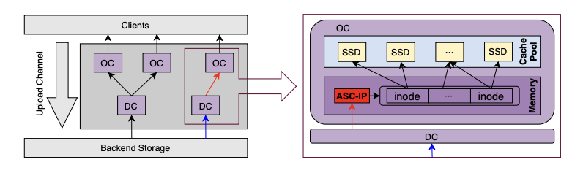
Implementation
In practice, a shadow cache is a history list to record the metadata of these evicted objects. The memory overheads are low since only a few metadata must be tracked, including the key of the object (string) and object size (long int).
Notes:
In practice, storage and computational overhead often limit the application of many complex algorithms. But in ASC-IP, A shadow cache is used as a history list to record the metadata of these evicted objects. The memory overheads are low since only a few metadata must be tracked, including the key of the object as a string and the object size as long int. And The computational complexity of ASC-IP is basically the same as that of LRU algorithm.

Slide 14
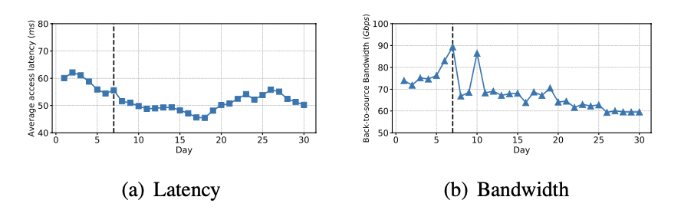
Improvement
After deploying ASC-IP-LRU (black dashed line), the average user access latency dropped by 7.14ms, and the back-to-source bandwidth dropped by 8.75Gbps.
Notes:
After deploying ASC-IP, we observed from our monitoring system that the average user access latency and WAN bandwidth have been decreased.

Slide 15
Conclusion
To reduce the consumption of cache resources by zero-reuse objects in CDNs, we explored the necessity of improving the insertion policy.
Given the large size variation in CDNs, we analyzed and found the relationship between the zero-reuse object and the object sizes.
Based on these cues, we proposed an adaptive size-aware cache insertion policy (ASC-IP). ASC-IP has strong practicality.
Notes:
Finally, a summary of our paper. By analyzing the real traces of CDN, we found the limitation of zero-reuse objects on CDN performance and the relationship between zero-reuse objects and object size. Based on this, we propose a lightweight insertion policy to improve existing caching algorithms. Since the insertion policy does not change the data structure in the basic replacement algorithm and the lightweight design of ASC-IP, this policy has a strong practical application value.

